Slide 1

How can a service designer contribute to accessibility?
Stéphanie Krus
17 September 2025

Slide 2
What I will take you through
How the guidance was created
Making your service accessible
Design communications
Designing together
Key takeaways and resources to learn more

Slide 3
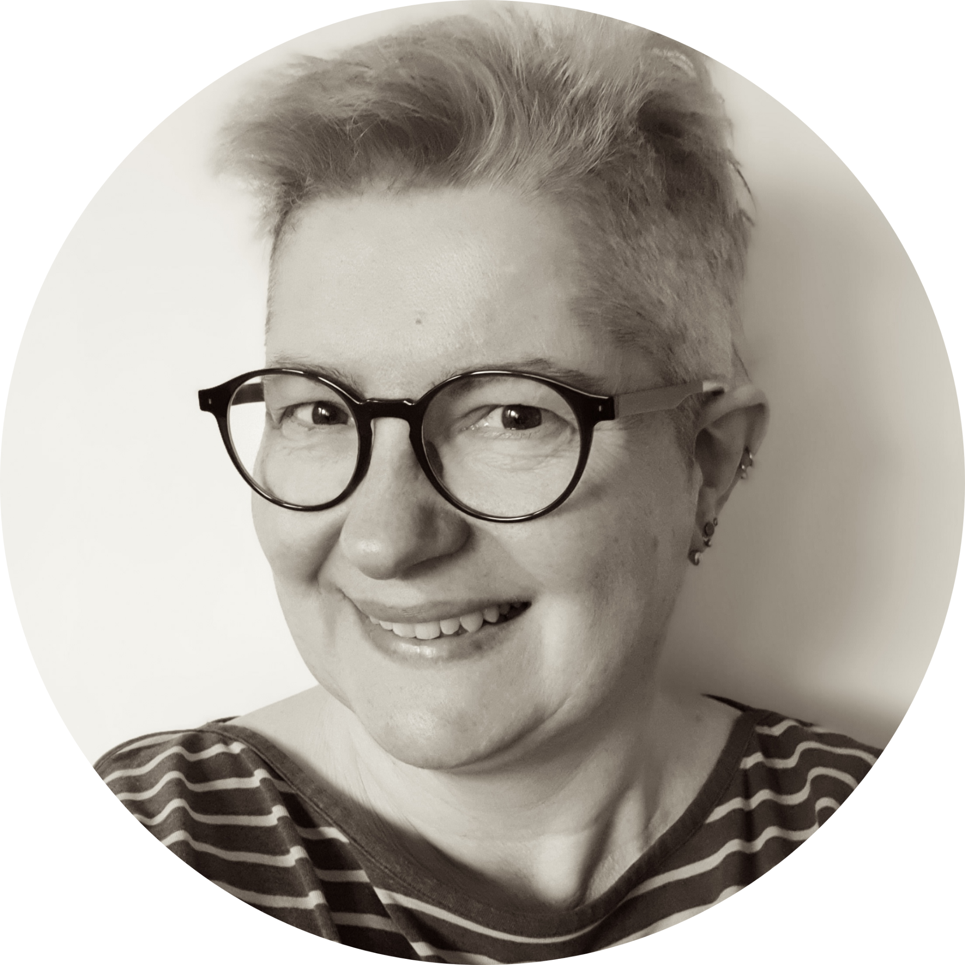
About me
I’m a service designer
my pronouns are she/her
very keen on accessibility and inclusion
Notes:
So usually this is where I stop, but to tell you the story about how we came up with a new guidance for the service designer role in the accessibility manual, I need to tell you a bit more about me

Slide 4



Learning about accessibility
2016
Software developer
2018
UX designer
User Researcher
2019
Service designer
Learn how to code so that the interface is accessible for people using it
Test my code, use screen readers and magnifiers
Use the design system correctly
Recruit disabled people for UR, plan more time, ensure consent works
Still one of the people going on and on about accessibility
Start public speaking about it
Notes:
in 2016 I was a graduate developer for MoJ - I was learning about accessibility from the GOV.UK service manual, from senior colleagues, and it was about how to code so that the interface would be accessible for people using it. I learned to test my code and to use screen readers and screen magnifiers to check the result.
in 2018, I switched to UX design - so being accessible was more about the design, using the right components, colours, using the design system correctly, but I also did some research, for this, it was about recruiting people who were disabled, planning more time for them and ensuring that my consent form enabled them to really understand what they were consenting to. I was lucky at the time as it was easy to recruit because I had access to a person who could help me and very well connected in the community
in 2019 I finally became a Service designer! I was still often the one person going on and on about accessibility in my projects, and this is when I started public speaking about accessibility

Slide 5
Each role in a multi-disciplinary team has a part to play to avoid making a service inaccessible
Notes:
Because of my experience going from one role to another, I was very aware that each role in a multi-disciplinary team has a different part to play to avoid making a service inaccessible.
It works better if everyone knows their part, so that the accessibility of a service do not rely on one single very keen individual reminding everyone what they should be doing.
This is why guidance per role feels really important to me.

Slide 6
Story time:
DWP Accessibility Manual
Notes:
So, now I’m going to tell you the story of how the guidance for the service designer role was created for the DWP Accessibility Manual

Slide 7
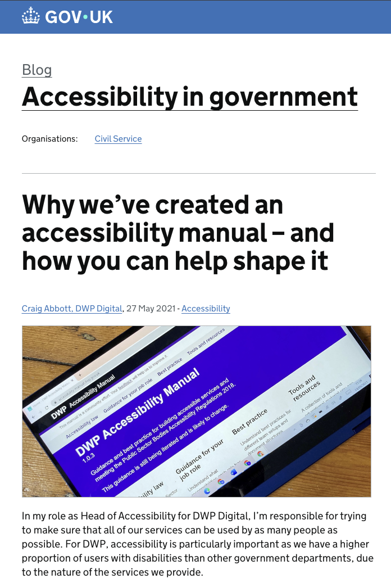
May 2021
Business analyst
Content Designer
Delivery Manager
Digital Performance Analyst
Interaction Designer
Product manager
QA tester
Software Engineer or Frontend Dev
User Researcher
Notes:
When the manual was first created in 2021, it was unique. Nothing like that existed in government even though it was badly needed.
Now there is also the DfE accessibility and inclusion manual but in terms of guidance per role, they do not have much yet.
The manual was very useful and very well received at the time. My favourite part was the guidance per role, so I started pointing people to it during my presentations, at work, or outside work,
You could find the guidance for the roles on the slide but there was no guidance for the service designer role
There was also nothing for the Accessibility specialist role, but it’s been added since.
Blog post announcing the launch: https://accessibility.blog.gov.uk/2021/05/27/why-weve-created-an-accessibility-manual-and-how-you-can-help-shape-it/
You can access the manual in the state it was at the time via this link, using the wayback machine: https://web.archive.org/web/20210731122848/https:/accessibility-manual.dwp.gov.uk/guidance-for-your-job-role

Slide 8

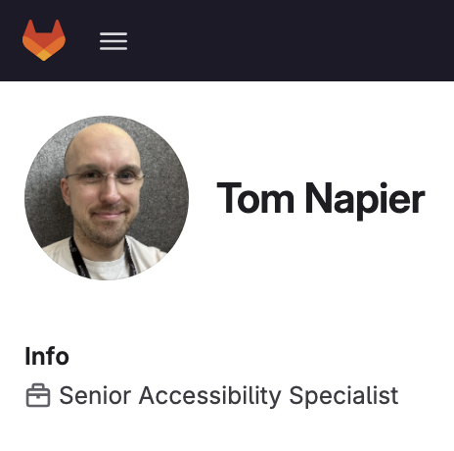
Joining DWP in 2023
2 reasons:
not enough time
unsure what a service designer does
Notes:
When I joined DWP in 2023 as a contractor, I talked to Tom Napier, he is a senior accessibility specialist.
I contacted him about the project I was on, but in the conversation, I mentioned the manual and it turned out he was the one in charge of maintaining it,
I told him how I kept directing people to it, even before I joined DWP, but then the service designer role was missing from the list.
I asked if there was a reason, if it was something I could help with.
There were 2 reasons, not enough time just now, but also he was unsure about what a service designer does and how this contributes to accessibility.
So I don’t know about the other service designers in the room, but every time I join a project team, no one seems to be too sure about what a service designer do …. apart from creating maps maybe?
I keep having to explain what I do.
Tom was happy to work on a guidance with me.

Slide 9
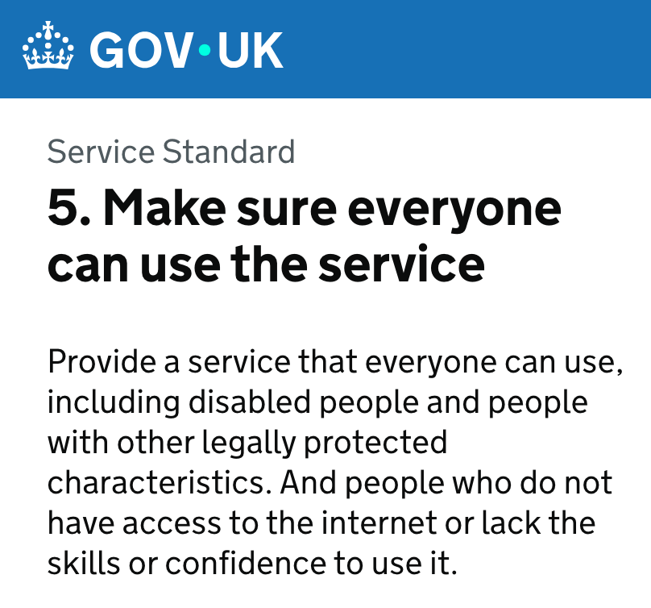
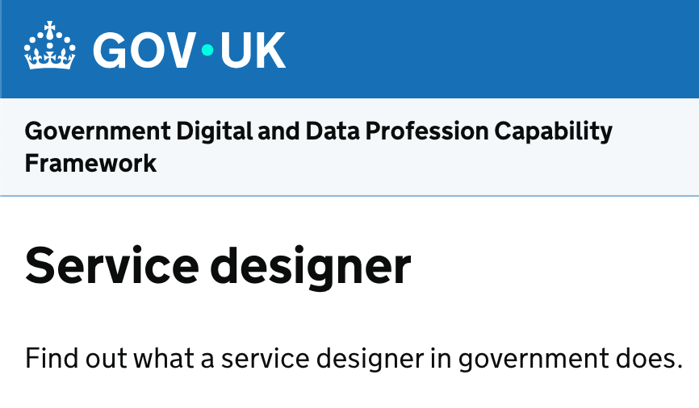

The service designer role
My own practice
Notes:
So I was very happy about this and started looking at:
point 5 of the service standard which describes what is needed to make sure everyone can use the service, which includes disabled people.
I also looked at the guidance of the Department for Education’s guidance on how to apply the service standard for point 5 as they go in a bit more details
I’ve checked the description of the service designer within the Government Digital and Data Profession Capability Framework
and finally, I’ve added elements from my own practice as a service designer
So that’s all the material I had to start working on a guidance.
Links to material:
https://www.gov.uk/service-manual/service-standard/point-5-make-sure-everyone-can-use-the-service
https://apply-the-service-standard.education.gov.uk/service-standard/5-make-sure-everyone-can-use-the-service
https://ddat-capability-framework.service.gov.uk/role/service-designer

Slide 10
Involving the Service Design Community (1)
Plot twist 1
Service Design Community monthly meeting
Plot twist
2
Sept 2024
Dec 2024
Feb 2025
Notes:
So that was my initial plan, but I wanted to involve the wider service design community in DWP too, because I’m just one service designer, and there are different ways to practice service design.
working on this with the DWP Service design community September 2024
So enters Lindsay Stephens, who organises the Service Design community events in DWP along with Shalom. There was nothing planned for the next one, so I suggested presenting what I had done to give some context, and then we could work on this as a community. We had invited Tom to the session so he could hear first hand what we felt our role was regarding accessibility.
Plot twist 1 - contractor’s life, my contract was terminated earlier than planned in December
Plot twist 2 - I got a new contract in DWP in February 2025
I contacted Tom again, asking if he add worked on the guidance, and he had a really good draft already - I gave him feedback, but again I felt I needed to involve the Service Design community again, and we had a Community day coming up in March.

Slide 11
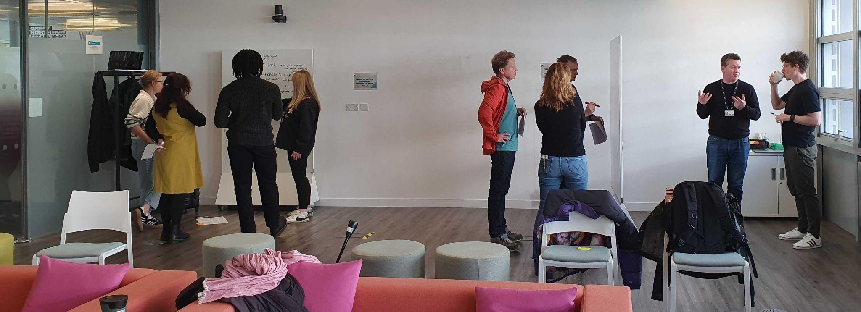
Involving the Service Design Community (2)
Notes:
So again we worked on this in groups to refine the guidance and it got much better as a result.
We had a few questions as well, for example, we needed resources for physical accessibility, because as service designer we look at all the channels, not just the digital ones and wanted to make sure we had pointers in the guidance to help with making physical events accessible.
Tom added some good sources on this and shortly after the guidance was published.

Slide 12
Takeaways from that story
never too old to change career
you can contribute to the community of practice as a contractor
involve contractors in your community of practice
keep pushing
involve other practitioners
Notes:
By myself I can do a lot, and can control the timeline better, but by involving the service design community, it took this guidance much further, and made it better in the end.

Slide 13
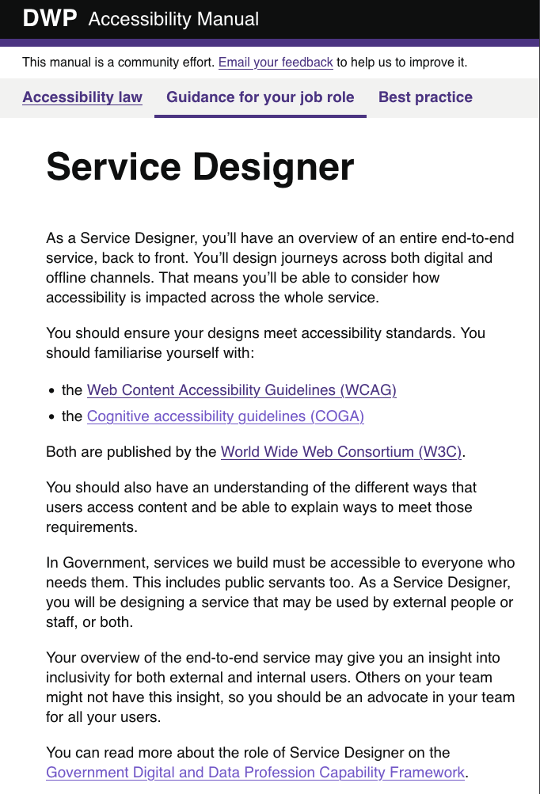
April 2025
WCAG Conformance
Non-digital accessibility
Design communication
Design together
When you can’t make a part of your service accessible
Notes:
Since April 2025, the service designer role has its guidance page. Which makes me really happy.
I’m going to tell you a bit more about the guidance itself now that you now how it came to be created.
It covers the bullet points on the slides, and I’m going to go in a bit more details about each of them during the rest of the talk.
Guidance for the service designer role: https://accessibility-manual.dwp.gov.uk/guidance-for-your-job-role/service-designer

Slide 14
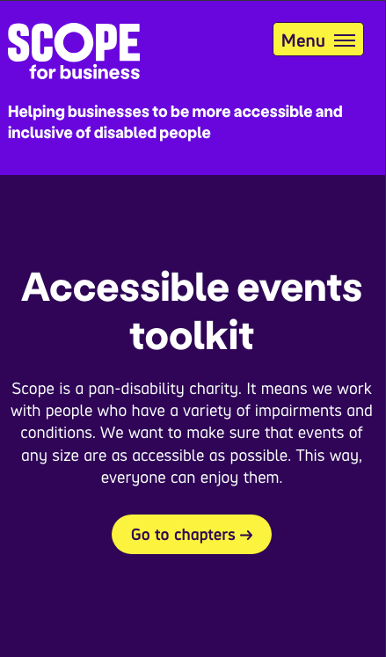
What’s different in the role?
“Your overview of the end-to-end service may give you an insight into inclusivity for both external and internal users”
“You’ll design journeys across both digital and offline channels”
Non digital accessibility
Notes:
So first, what’s actually different and specific to this role?
Others on your team might not have this insight, so you should be an advocate in your team for all your user, both internal and external.
Parts of your service, as well as some of your design activities, might occur offline, or non-digitally. You must consider non digital accessibility too.
Disability charity Scope has lots of guidance around accessibility in the built environment. Scope provides guidance for users on how to check the accessibility of an event or venue. This can be useful to understand what things people may consider when attending somewhere in person. Scope for Business also have an accessible events toolkit that you may find useful.
Links to the material:
https://www.scope.org.uk
https://www.scope.org.uk/advice-and-support/checking-event-venue-accessibility
https://business.scope.org.uk/toolkit/accessible-event-planning-toolkit/

Slide 15
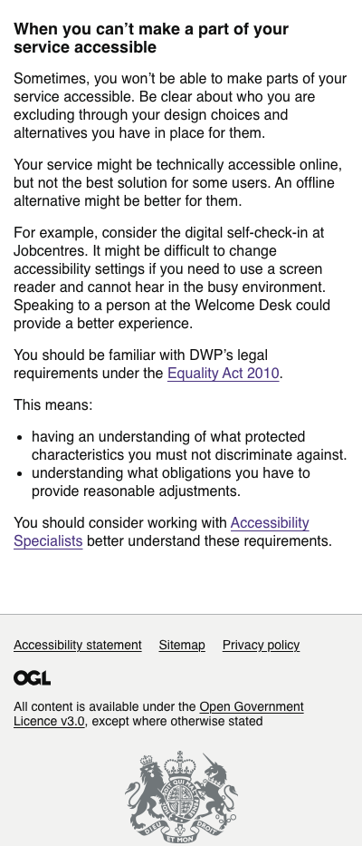
When you can’t make part of your service accessible
a service, technically accessible online might not be the best solution
you can and should ask for help from accessibility specialists
Notes:
there is 2 meanings to this: you are in a situation where an alternative option is a better than spending a lot of time on making a digital self-serving solution more accessible
For example, consider the digital self-check-in at Jobcentres. It might be difficult to change accessibility settings if you need to use a screen reader and cannot hear in the busy environment. Speaking to a person at the Welcome Desk could provide a better experience.
Bringing the community along with me to improve the guidance highlights that some service designer might not know how to make things accessible by themselves. We are not trained to do this, so if no one in your team can help, you need to work with accessibility specialists (in your department, cross government, but you could also bring in associations)

Slide 16
Covering the bases
Notes:
Before I explain further parts of the guidance, I want to cover some bases. Because as I’ve just mentioned, it’s very likely that some in the room do not know about accessibility

Slide 17
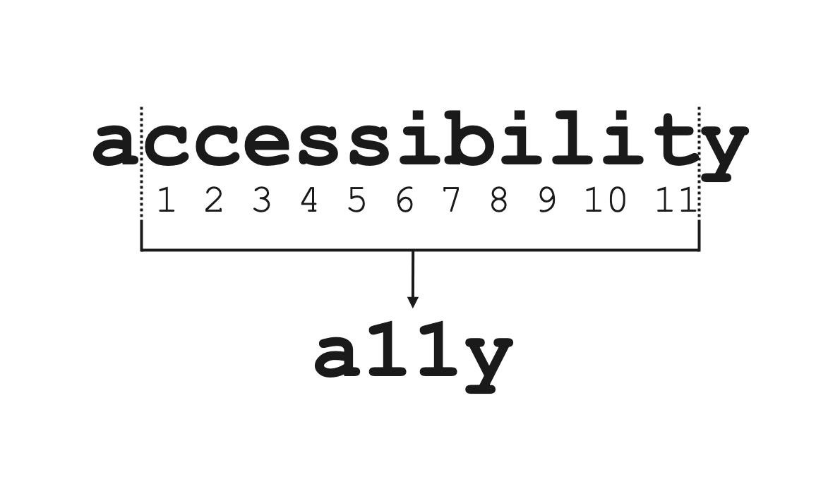
Accessibility

Slide 18





1 in 4 people are disabled in the UK
vision hearing speech motor cognitive
It’s different for everyone
Notes:
1 in 4 people are disabled in the UK
A disability can affect your vision, your hearing or your speech.
It can be a physical disability​ or a cognitive disability​,
this means it affects your memory, ​or how you process things, communicate and think​.
It can also be a mix of more than one disability​.
In fact, it’s quite frequent that people have more than one disability
and they are not always visible to others.
It’s different for everyone
Source for 1 in 4 - disability prevalence by age group: https://www.gov.uk/government/statistics/family-resources-survey-financial-year-2022-to-2023/family-resources-survey-financial-year-2022-to-2023

Slide 19
Defining accessibility
“Accessibility means that people can do what they need to do in a similar amount of time and effort as someone that does not have a disability.
It means that people are empowered, can be independent, and will not be frustrated by something that is poorly designed or implemented.”
Source: GOV.UK Blog post

Slide 20
Web Content Accessibility Guidelines (WCAG)
→ Standard you need to comply with for digital accessibility
Currently, version 2.2
Web Content Accessibility Guidelines (WCAG)
Published by the World Wide Web Consortium (W3C)
Notes:
we have a link to this in the guidance, but it’s not always so easy to engage with - DWP accessibility manual have some more engaging guidance around this

Slide 21

Neurodiversity
Notes:
I’m going to tell you a bit more about neurodiversity as well.
It can be considered as a subset of accessibility.
When we talk about cognitive disabilities, it’s often related to neurodiversity.
So let’s look at it closer
The image on the slide is the infinity symbol with rainbow colours, and this is the symbol for neurodiversity.

Slide 22
An umbrella term
Dyslexia
Autism
ADHD (= Attention Deficit and Hyperactivity Disorder)
Dyspraxia
Dyscalculia
OCD (Obsessive Compulsive Disorder)
and more
Notes:
Neurodiversity is an umbrella term which cover conditions like Dyslexia, Autism, ADHD
and other ‘dys’ like dyspraxia, or dyscalculia, OCD and more. There is a lot of overlap between these conditions.

Slide 23
How it affects people
think, process information and language
interact socially and communicate with others
perceive space and time

Slide 24
1 in 7 people are neurodivergent in the UK
This is about 15 to 20% of the general population
But it’s often underestimated and under-declared.
It’s much higher for people working in Tech.
→ above 20% and probably up to 50% in tech and the creative industry
Notes:
1 in 7 people are neurodivergent in the UK - that’s about 15 to 20 % of the general population.
It’s often underestimated and under declared because even though things are improving, it’s still often perceived negatively, so people are wary of disclosing.
Many people don’t have a diagnosis, it takes a lot of time to get one, and some people are not even aware that they are neurodivergent, especially women, as the description of these conditions are still full of stereotypes and more representative of young boys than girls and even less of adult women who often have learned to cope and mask.
It looks like these numbers are much higher for people working in tech.
It’s very hard to have reliable numbers
Some of the numbers are showing that it’s above 20% in tech and the creative industry and probably up to 50% in some cases.
So if you consider the people in your team, it’s very likely that quite a few are neurodivergent.
I’ll come back to this at the end when talking about designing with your team and communicating your design.
Sources for the numbers:
Major new report from the Tech Talent Charter reveals tech employers massively underestimate neurodivergence - We are Tech women (Feb 2024): https://wearetechwomen.com/major-new-report-from-the-tech-talent-charter-reveals-tech-employers-massively-underestimate-neurodivergence-in-their-workforce/
What it’s like being neurodivergent in the creative industries - Creative review (Avril 2024): https://www.creativereview.co.uk/neurodiversity-creative-industry-experience/
Written evidence given to a UK Parliament committee (PDF) - https://committees.parliament.uk/writtenevidence/6613/pdf/

Slide 25
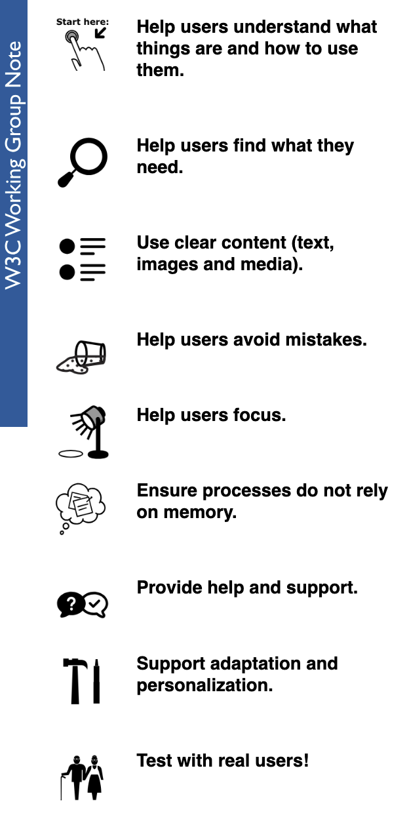
Cognitive Accessibility Guidelines (COGA)
→ set of guidelines for inclusive design
Also published by the W3C.
Nice COGA version by the Department for Education
Notes:
a set of guidelines for inclusive design.
cover a lot of issues around neurodiversity
and was included in the guidance for our role as it’s very useful
The Department for Education has a really engaging version of COGA [ link on the slide]
screenshot of the W3C working group note showing the principles one under another with an icon for each.
The list is:
Help users understand what things are and how to use them.
Help users find what they need.
Use clear and understandable content
Help users avoid mistakes and know how to correct them
Help users focus
Ensure processes do not rely on memory
Provide help and support
Support adaptation and personalisation
test with real users!

Slide 26
Accessibility → Inclusion
Inclusion
→ respect the identity and circumstances of each person
Accessibility
→ include disabled people
Neurodiversity
Notes:
To finish covering the bases, I want to talk about the scope of the guidance.
It is for accessibility, which includes neurodiversity.
But many neurodivergent people do not consider themselves disabled, so I chose to represent it as different shape on this slide but still overlapping with accessibility.
As a service designer, we should be aiming for inclusion which is wider than just accessibility.
Point 5 of the service standard mentions disabled people but also digital capability, as we need to include people who do not have access to internet or who might lack the skills or the confidence to use online services.
Point 5 of the standard mentions digital inclusion but for for me, inclusion is even wider than accessibility and digital inclusion: it’s about respecting the identity and circumstances of each person using your service.
The guidance for the service designer role is mentioning inclusion a few times, but its focus is mostly on Accessibility.

Slide 27
Designing for everyone
Notes:
One of the skills needed for designers in government, is to be able to design for everyone. This part is about making your service accessible to your users

Slide 28
General recommendations
1 in 4 person is disabled
think of it right from the start
involve disabled people at every stage of your research
don’t forget internal users
everyone in your team needs to be involved
ask for feedback (accessible and not only online)
Notes:
Some general recommendations
You need to think about it right from the start, not at the very end as it will influence your decisions all along
1 in 4 people are disabled in the UK, so ideally, you should have a similar proportion of disabled people taking part in your research.
Don’t forget internal users, they could also have accessibility issues while delivering the service, so do think about them too.
Make sure everyone in your team understand how to avoid making things inaccessible without meaning to.
Everyone has a role to play.
Make it easy for people to tell you when something is not right.
Even if you have done a really good work, you are likely to overlook some issues, so this feedback is crucial to keep improving your service.
If your feedback mechanism is only online and not accessible, you are going to miss out on a lot of inclusion issues…
So make sure the way you request feedback is accessible and not only online.

Slide 29
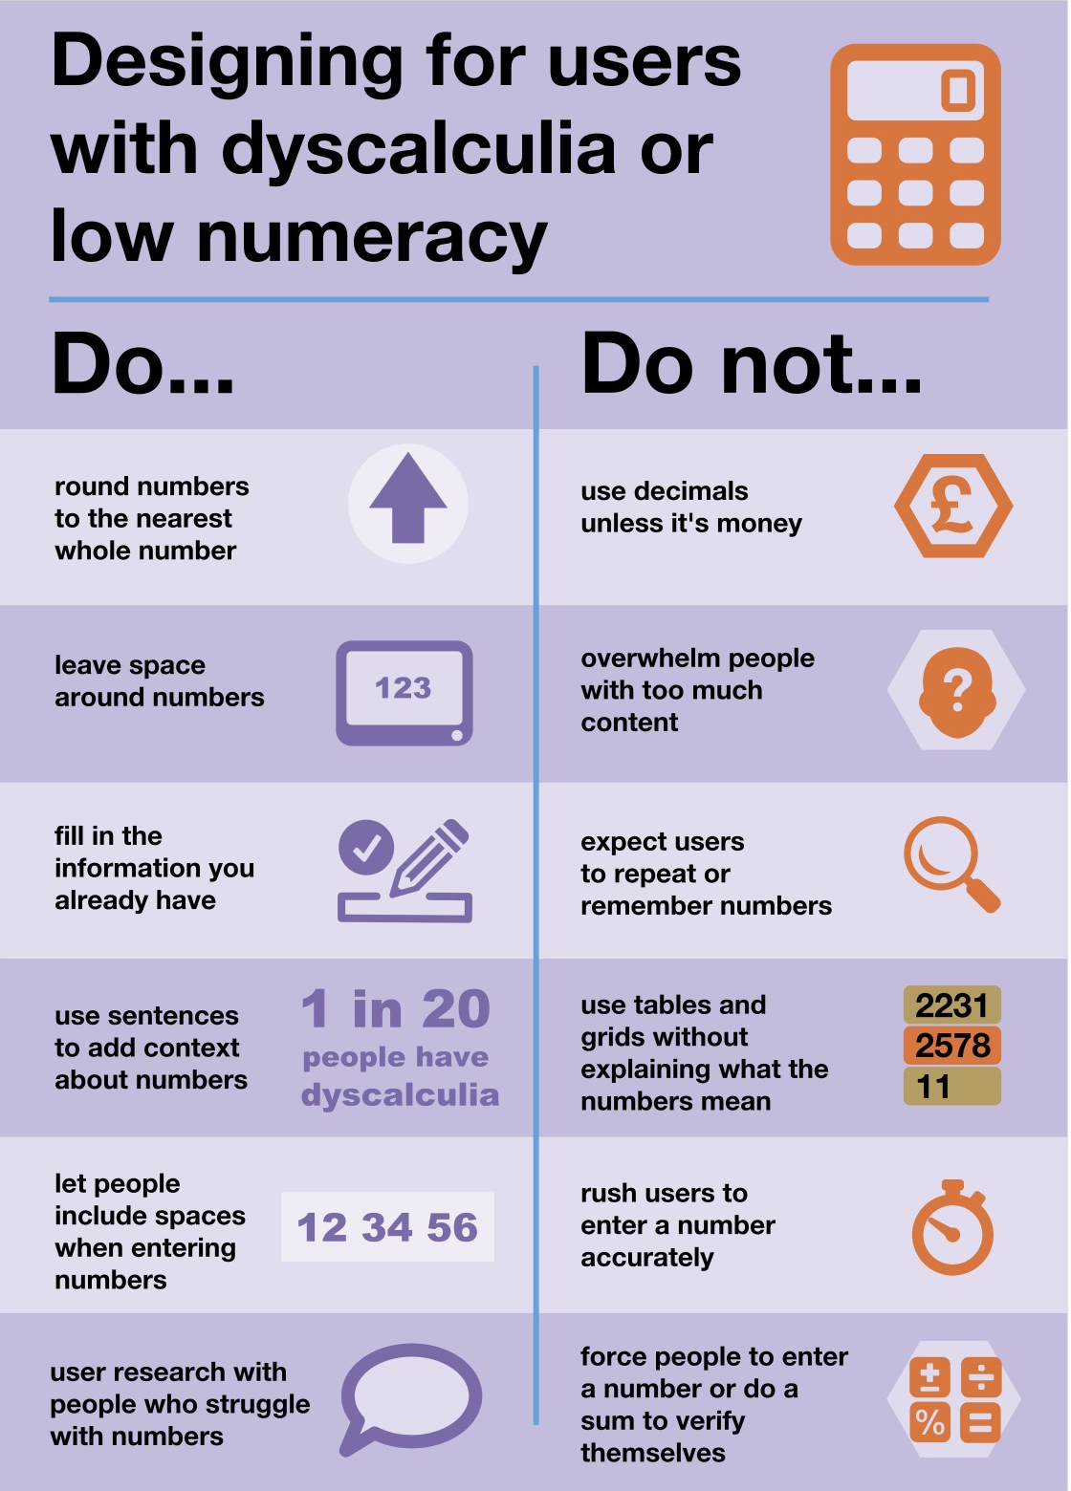
Numbers
Low numeracy affects half the working-age adults in the UK
Accessible numbers project by Laura Parker
Notes:
Don’t forget about users with dyscalculia and low numeracy.
Did you know that low numeracy affect half the working-age adults in the UK?
Check the Accessible numbers project by Laura Parker, and the poster Laura worked on with Rachel Malic and Jane McFadyen.
These 3 content designers came up with a new do and don’t poster for designing for people with dyscalculia or low numeracy which I’m showing on this slide
you can learn more about the poster in this blog post : https://designnotes.blog.gov.uk/2022/11/28/designing-for-people-with-dyscalculia-and-low-numeracy/
The accessible number project has advice and podcast episodes for you to learn more about the problems and how to do better.

Slide 30
End-to-end, back-to-front
Integration with other services
Asking Questions
Consistency
Service features guidance in the manual
Redundant entry
Accessible authentication success criteria
Notes:
In the guidance for a service designer, we have mentioned WCAG which is very wide, but for this role, we wanted to focus on a few points, which relates to the fact that we are the one person looking at the end-to-end and back-to-front service
Integration with other services
You should consider the accessibility of any other services you want to integrate with before deciding to include them in your design. These other services may have an impact on the accessibility of your design. For example, your service may pass the user to an authentication service before returning them to the main journey.
Asking Questions
Many services ask questions for users to answer. You should ensure that you don’t ask the user the same thing over and over.
This can be harder than it sounds. Repeated questions can be difficult to avoid when designing a complex service with many integrations.
Consistency
The way you navigate the service and ask for help should be consistent across integrations if possible. As well as testing features of the service, you should be testing whole journeys.
The DWP Accessibility manual has a Service features guidance part.
Service Designers should pay particular attention to it.
These pages provide more detailed information on the WCAG success criteria to should consider.
In particular: Redundant Entry and Accessible Authentication success criteria.
https://accessibility-manual.dwp.gov.uk/best-practice/service-features

Slide 31
Design communication
Notes:
Other skills needed by designers in government are around design communication. It’s about creating accessible outputs, and communicating your design decisions with the rest of your team, but also with your stakeholders.

Slide 32
Some basic steps
Use legible fonts, and structure your text with the right headings
check colour contrast especially for your text
do not rely on colour alone to convey meaning
use plain language and explain acronyms
be careful with numbers
use accessibility checkers for your slides
send your presentation ahead of the meeting when possible
Notes:
This is really for everyone in the team not just service designers

Slide 33
Maps
colour contrast are still important, and not just for the text
legible font is still important, but more flexibility on the size
beware: people will look for meaning in colours and alignment
not too much info, not too many colours and shapes
who is your audience? what’s your intent?
create alternative formats
Notes:
This one is more specific to service designers, because people do not always know what a service designer does, but we are usually known as the person ‘who does the maps’.
And these can be powerful tools to communicate your design.

Slide 34
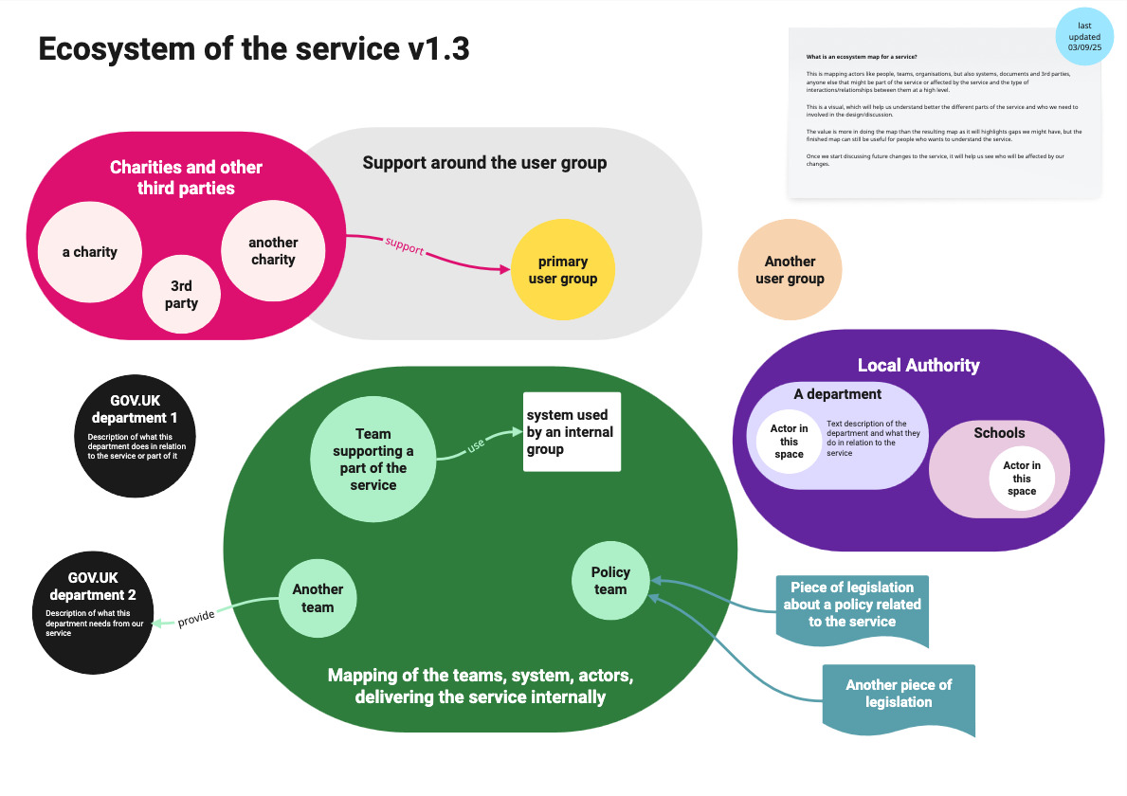
Example:
Mapping an ecosystem
Notes:
On this slide, I have a colourful ecosystem map.
At the top, I usually put a version number for that map, and in the top right corner, I usually explain what an ecosystem is and what we will use this for.
I also add the date when it was last updated.
The map itself show the usual elements I have in an ecosystem:
The primary group of users, and other groups …. potential support around the group, and charities and other 3rd parties. I will have some arrows to show the relationships between these groups
I often have a part showing the teams, the systems and actors who are delivering the service internally, and relations they might have with other government departments. Here I’ve put the policy team and relation to piece of legislation the service needs to comply with
And finally in this example, I’ve put a local authority part and within it departments with potential actors and what they do.
Once the mapping is in a good place, and I want to start sharing wider, I create an alternative format as a slide deck, and provide the same level of information but easier to use and engage for people who do not function visually or feel it’s too much to take in one go.
The alternative format is often easier to use to provide feedback.

Slide 35
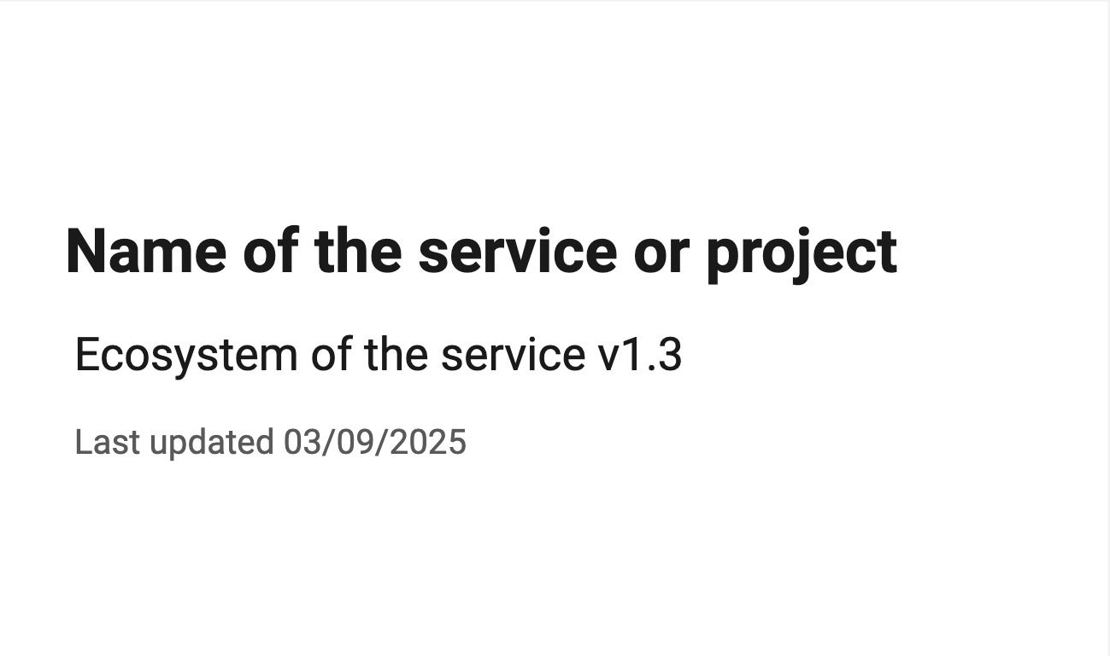
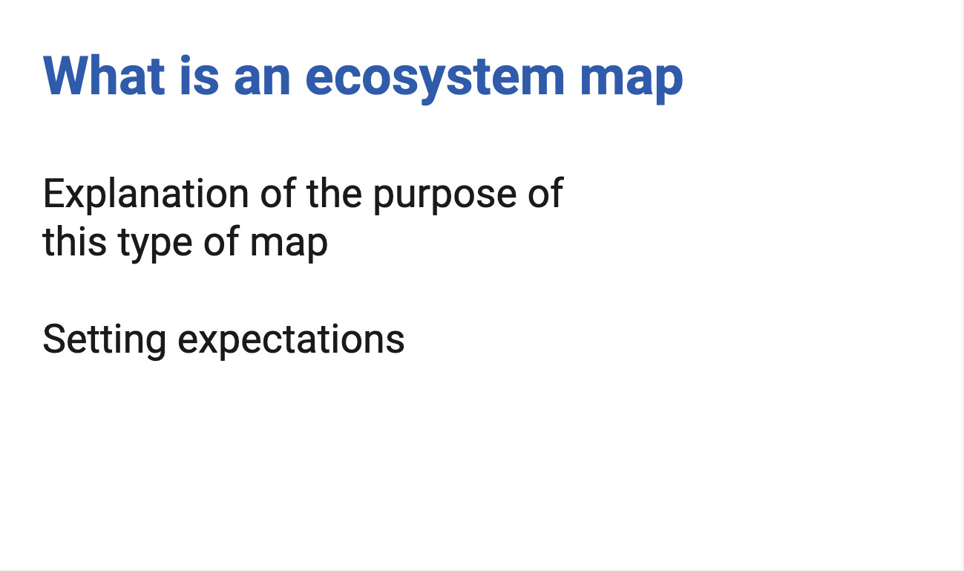
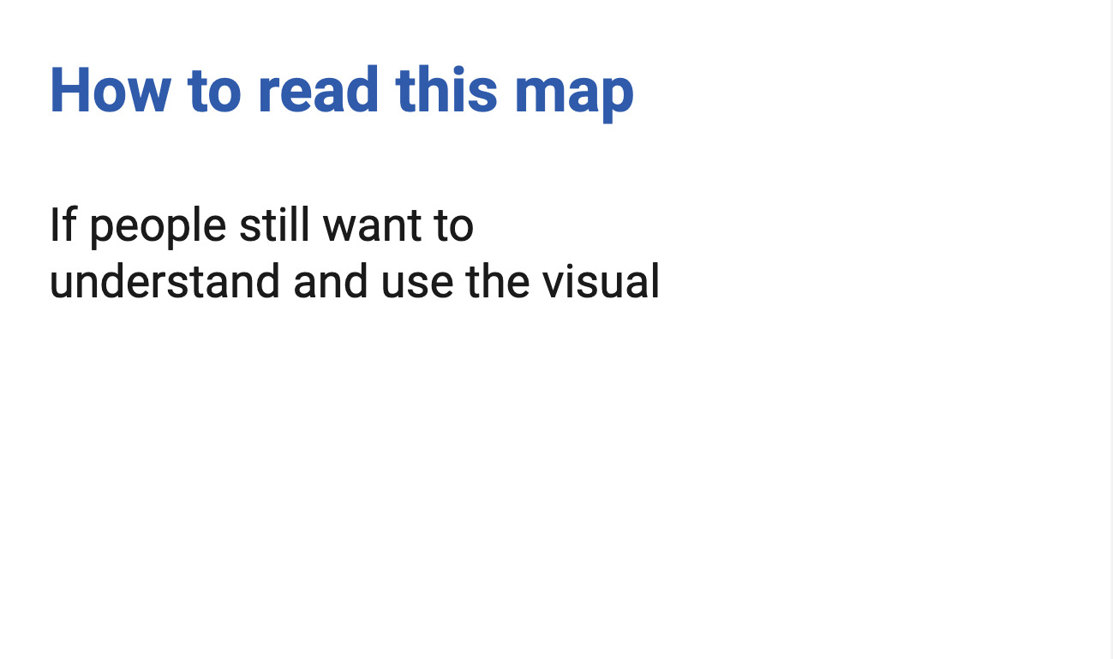
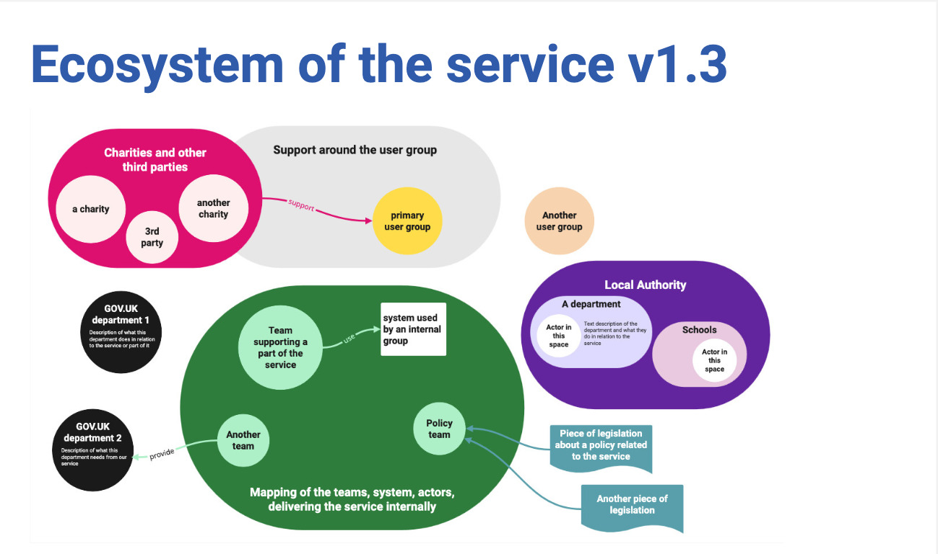
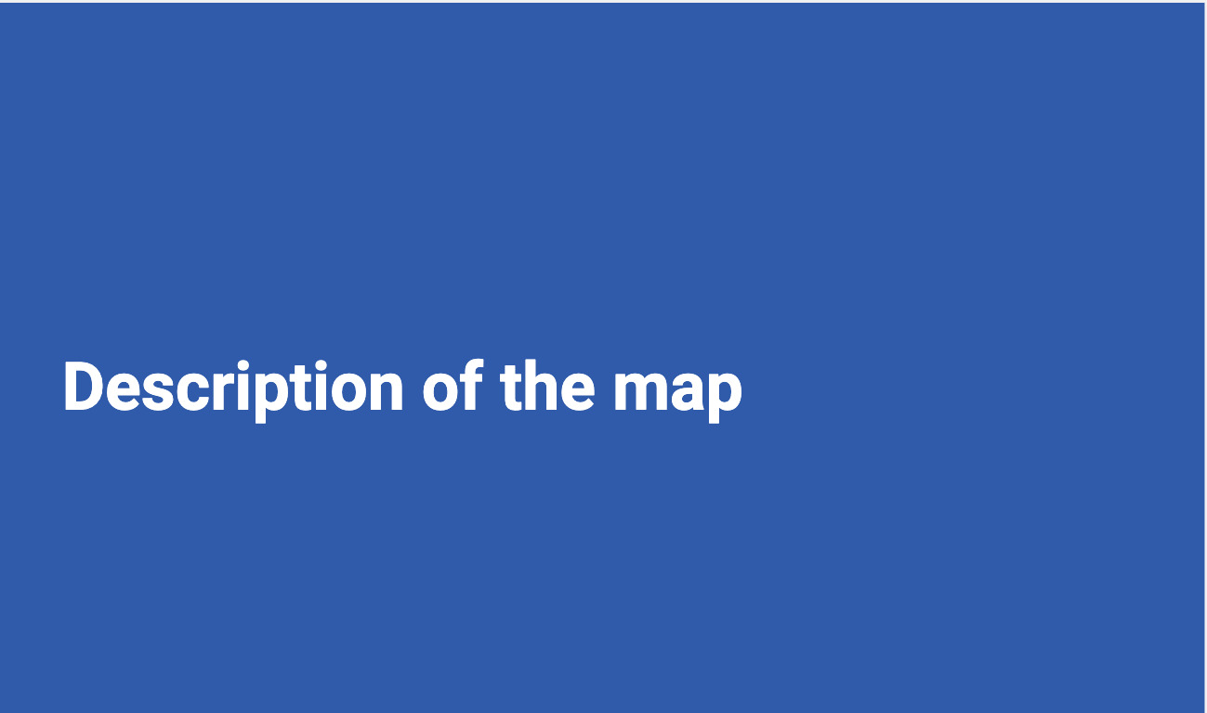
Example: Turning the ecosystem visual into a deck (1)
Notes:
I have an ‘educational slide’ and provide a link to a PDF version of the visual as some people might still be interest in seeing it, and then I provide a written description of the visual.
[explain what an ecosystem is]
“This is mapping actors like people, teams, organisations, but also systems, documents and 3rd parties, or anyone else that might be part of the service or affected by the service and the type of interactions/relationships between them at a high level.
This is a visual, which will help us understand better the different parts of the service and who we need to involved in the design/discussion.
The value is more in doing the map than the resulting map as it will highlights gaps we might have, but the finished map can still be useful for people who wants to understand the service.
Once we start discussing future changes to the service, it will help us see who will be affected by our changes“

Slide 36

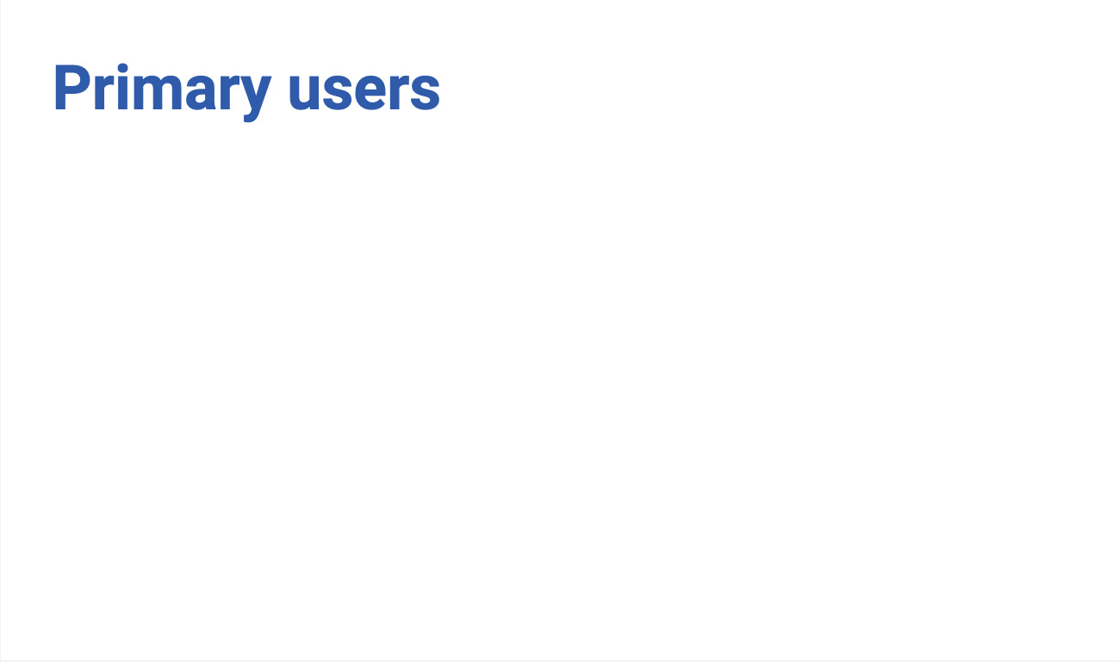
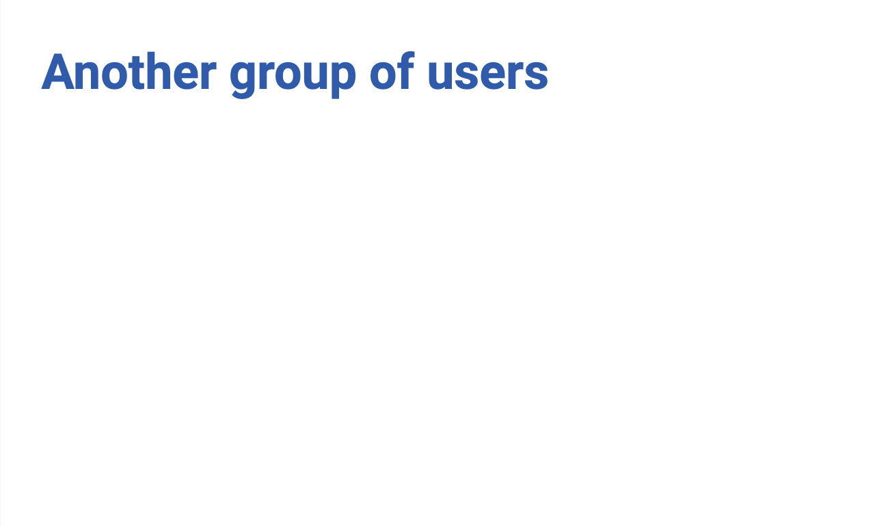
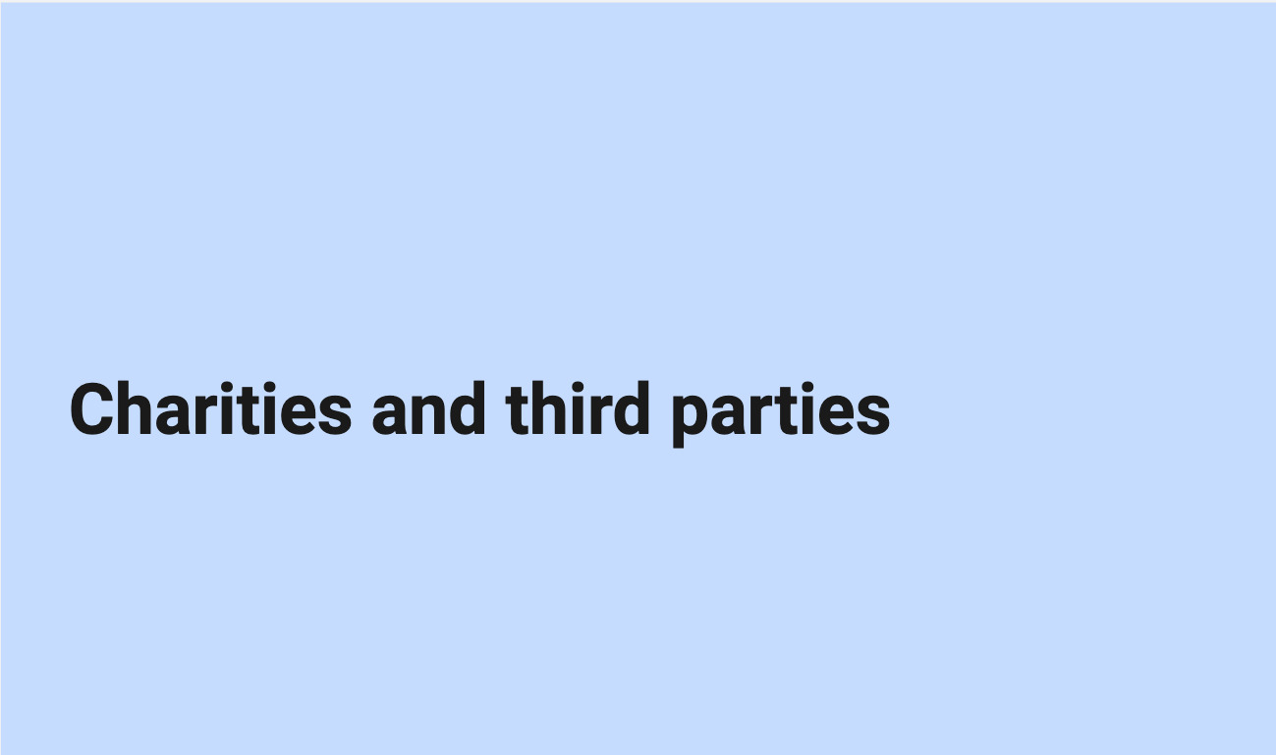
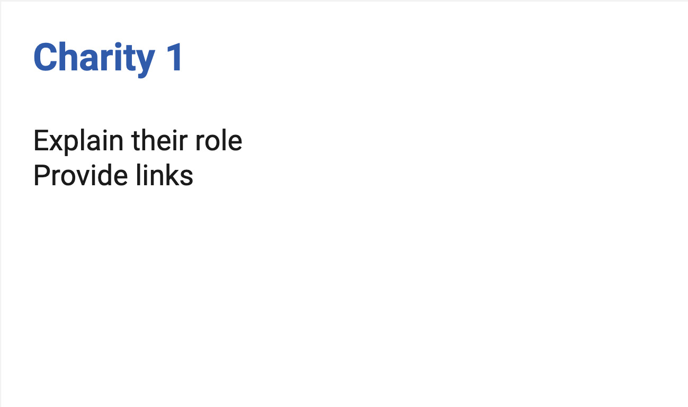
Example: Turning the ecosystem visual into a deck (2)
Notes:
I start with the users, and 3rd parties. In a deck I can provide a bit more information and add links. I describe the relationships which are sometimes less obvious in a deck.
It might have a bit of duplication compared to a visual.

Slide 37
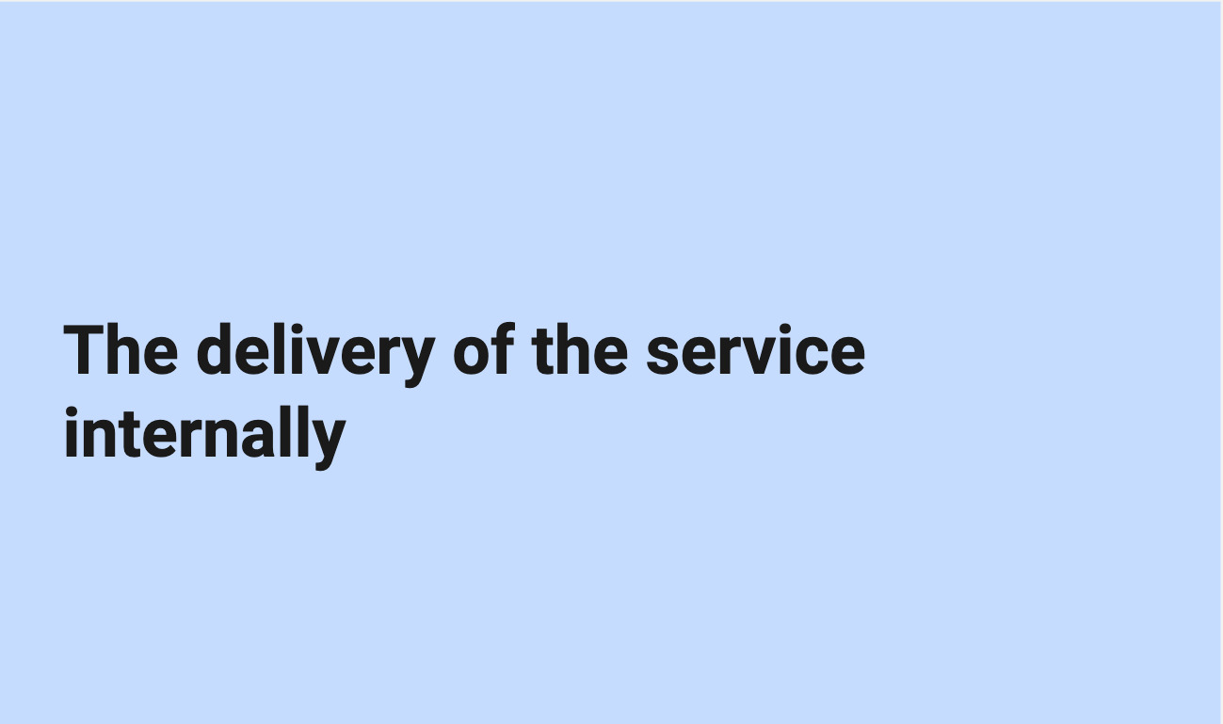
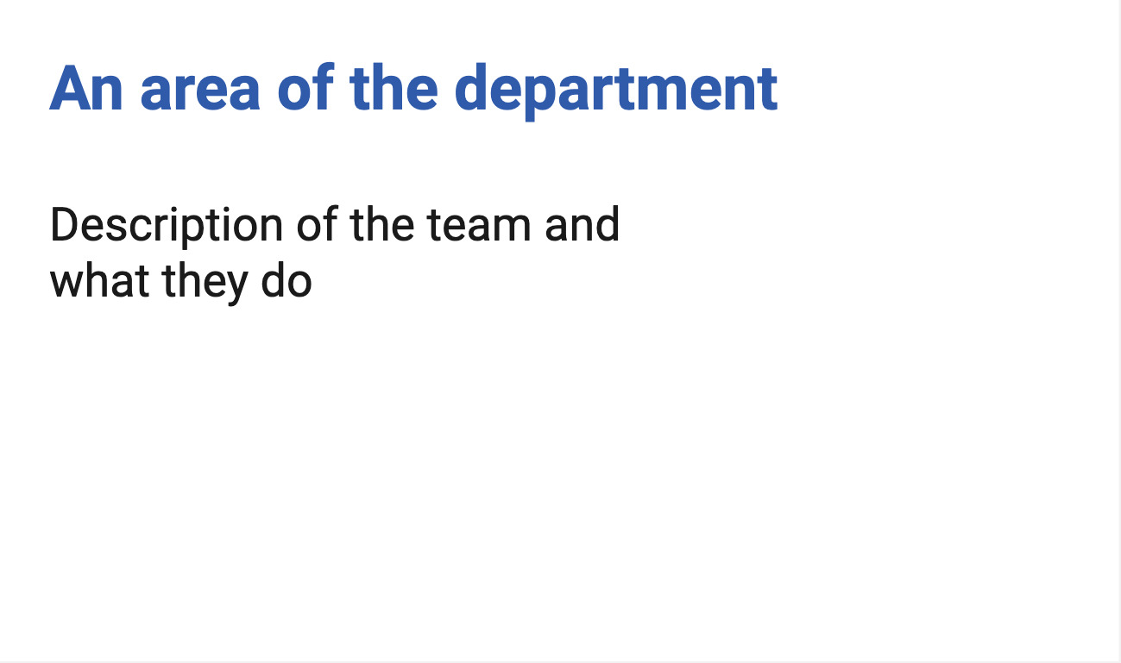
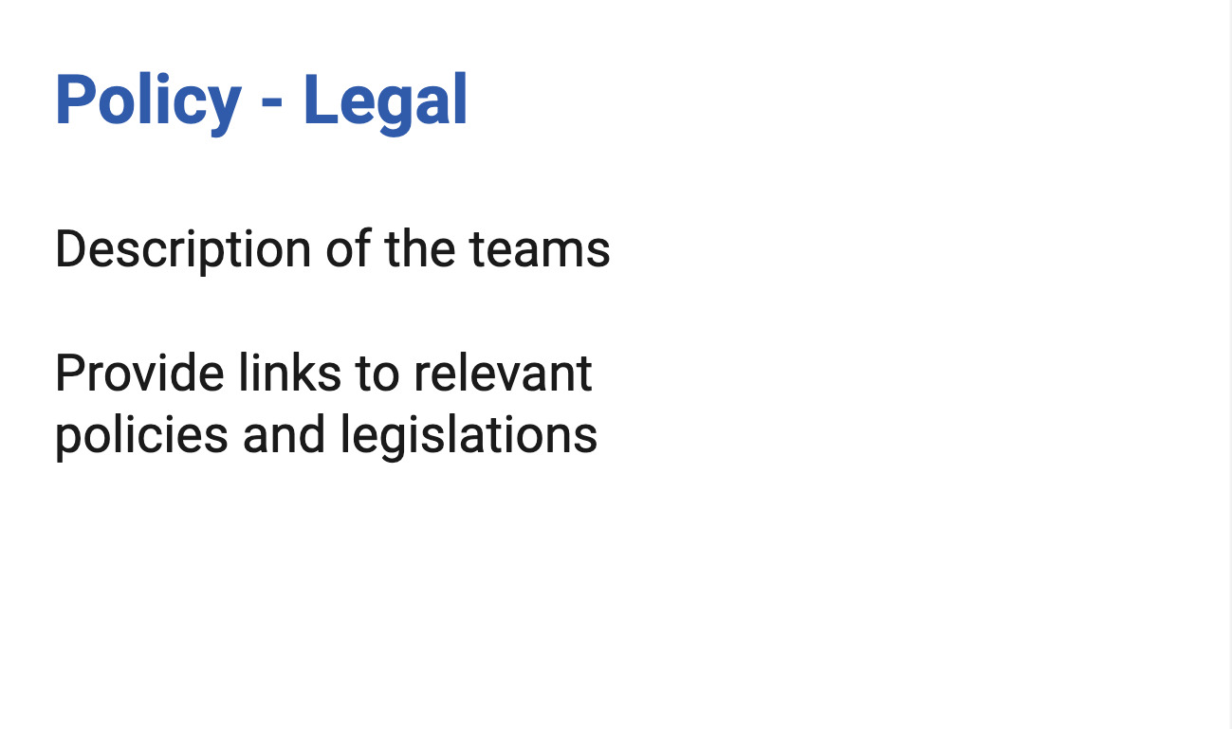
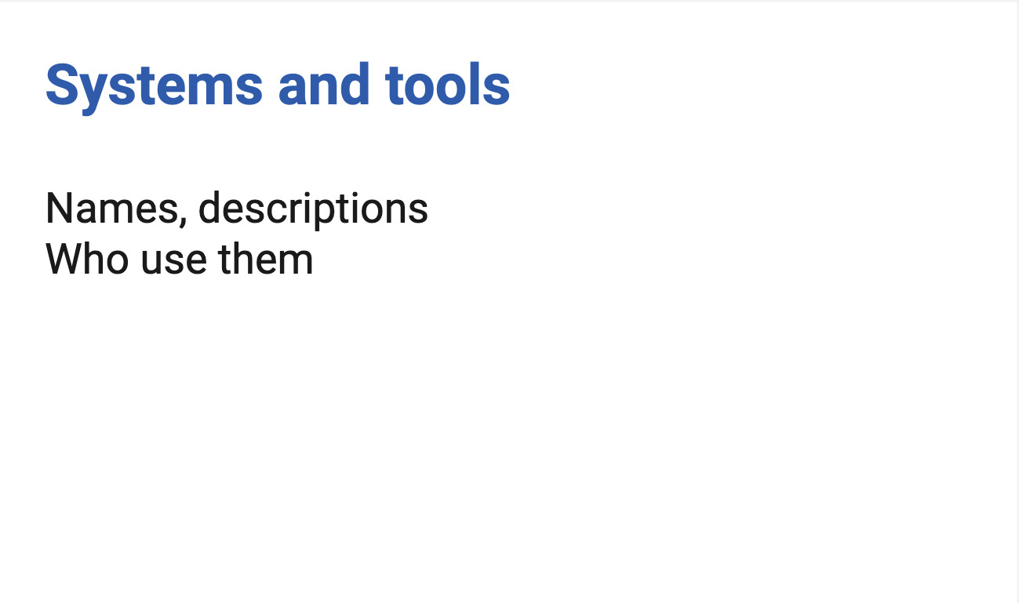
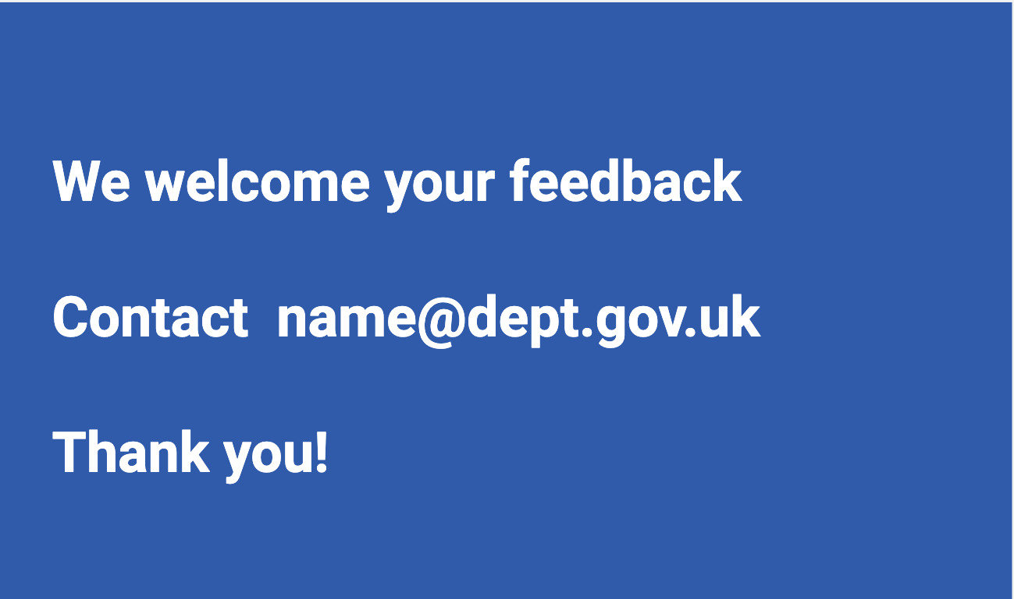
Example: Turning the ecosystem visual into a deck (3)
Notes:
I have another part to explain the internal aspects of the delivery of the service, and some areas which were a shape on the visual. I often have one or more slides about the policy and legal aspects, names of the teams and links to related legislation when relevant, and I have a part on the system and tools, where I explain who uses them.
Finally, I invite for feedback so I can improve when things were missing, incorrect or confusing.
I get a lot more feedback that way, especially from people in operations.

Slide 38
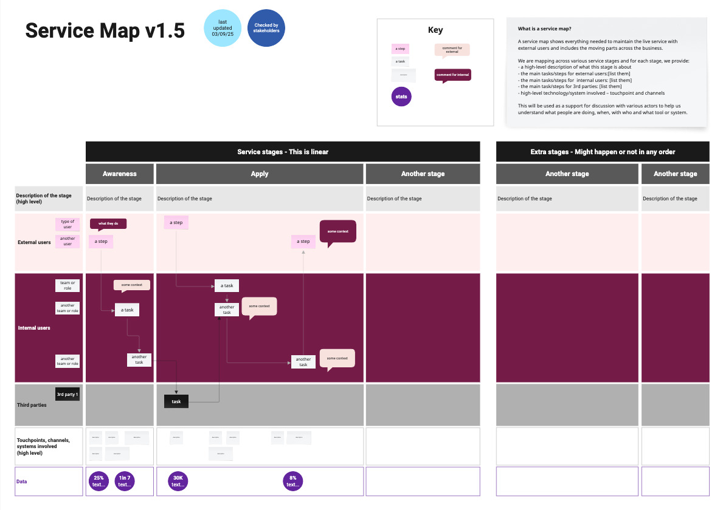
Example:
A service map
Notes:
So again, I cannot share an actual map, but I’ve recreated one. This time it’s a service map.
I have a version number, and in the top right corner, I explain what a service map is and what we will use this for, I provide a key for the colours and shapes I’m using and I also add the date when it was last updated, and also say if it’s has been checked by stakeholders or not.
The map itself show the usual elements I have in a service map:
The column are each stage of the service, some are linear, here I’ve put awareness, apply, and another stage - And then more stages which might happen or not in any order.
For the rows, I have a first row that describe each stage at a high level, then a row for the external users and sub rows if there are different types, then one for internal users, again I might have different layers for different type of internal actors. I often have an extra row for third parties delivering the service too
Under this, I have a row for the touchpoints, channels and systems involved at a high level and finally, a row where I add a bit of data when I have it about this specific stage. Across all this, I have boxes explaining tasks, events and arrows connecting them to understand the flow of the steps.
Once the mapping is in a good place, and I want to start sharing wider, I create an alternative format as a slide deck - But this time, I slice the mapping differently.

Slide 39
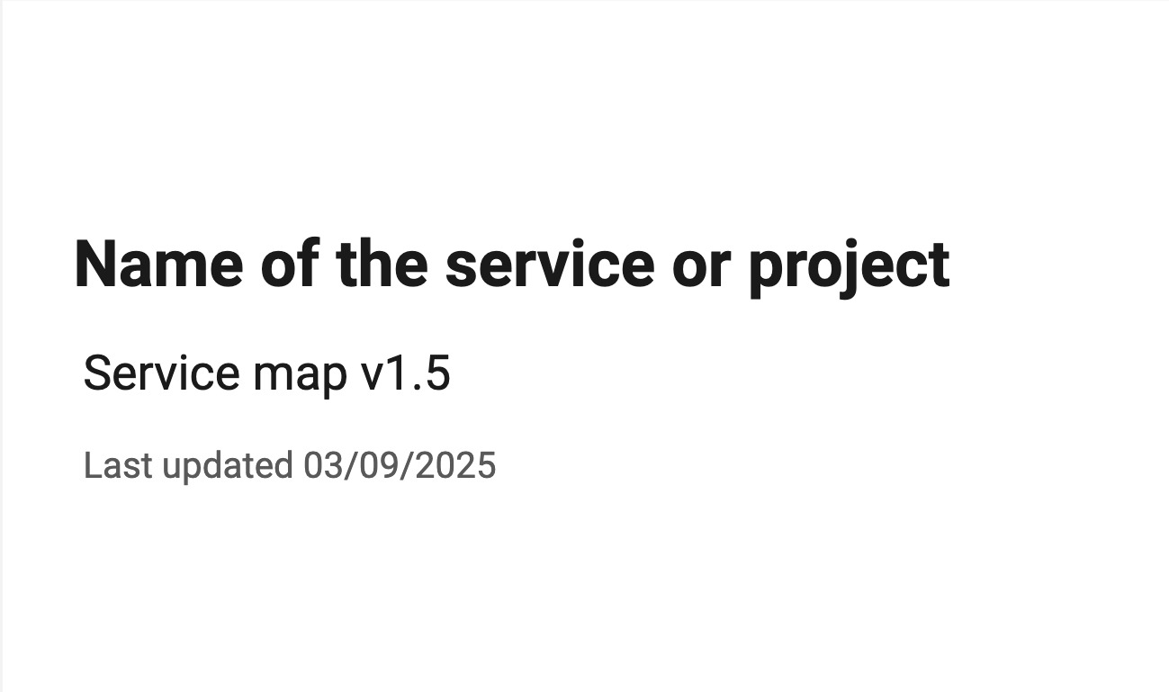
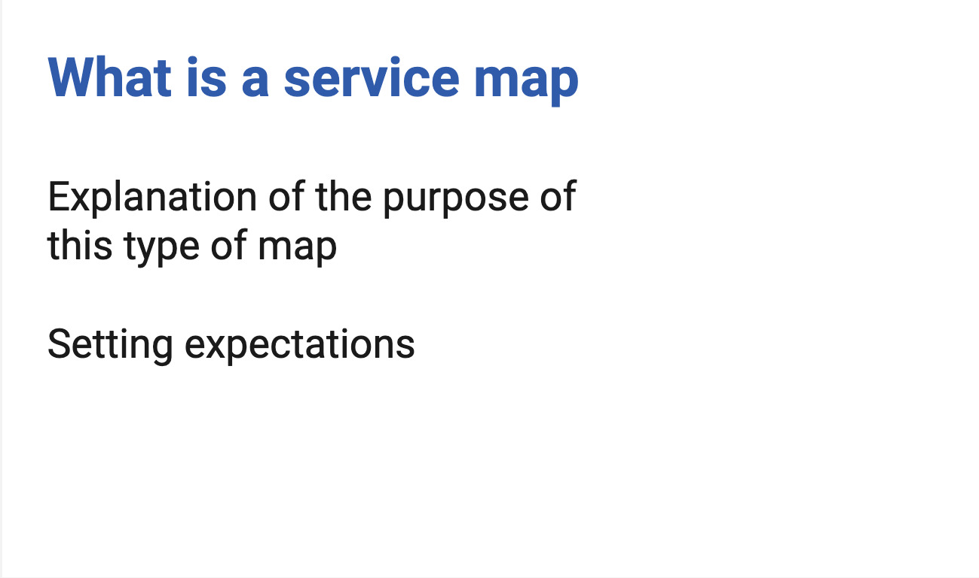
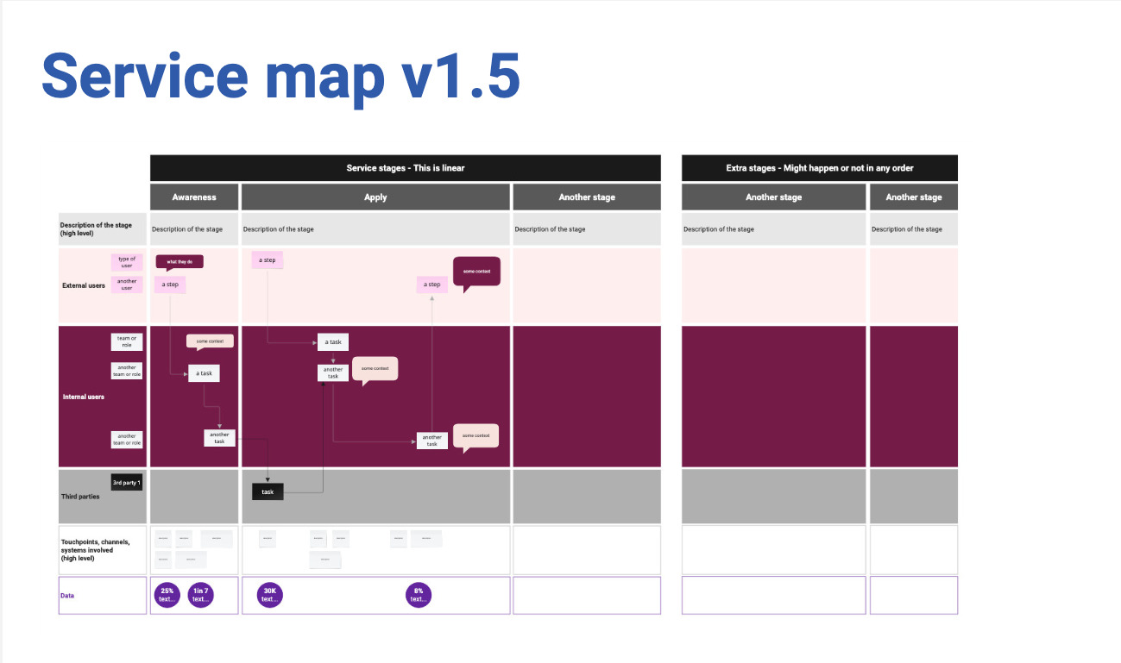
Example: Turning the service map visual into a deck (1)
Notes:
I still have an ‘educational part’ to the document and provide a link to a PDF version of the visual as some people might still be interest in seeing it, and then I provide a written description of the visual.
[explain what a service map is]
A service map shows everything needed to maintain the live service with external and internal users and includes the moving parts across the service.
We are mapping across various service stages and for each stage, we provide:
a high-level description of what this stage is about
the main tasks/steps for external users, internal users and 3rd parties
high-level technology/system involved – touchpoint and channels
This will be used as a support for discussion with various actors to help us understand what people are doing, when, with who and what tool or system are used

Slide 40
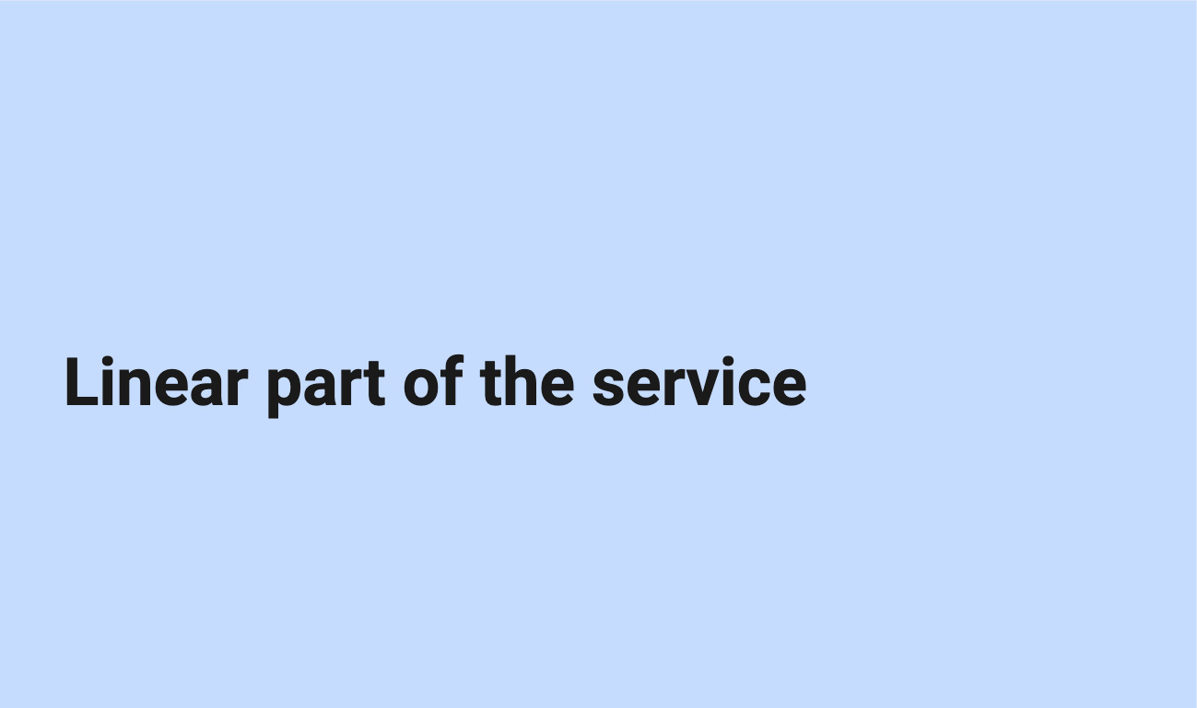
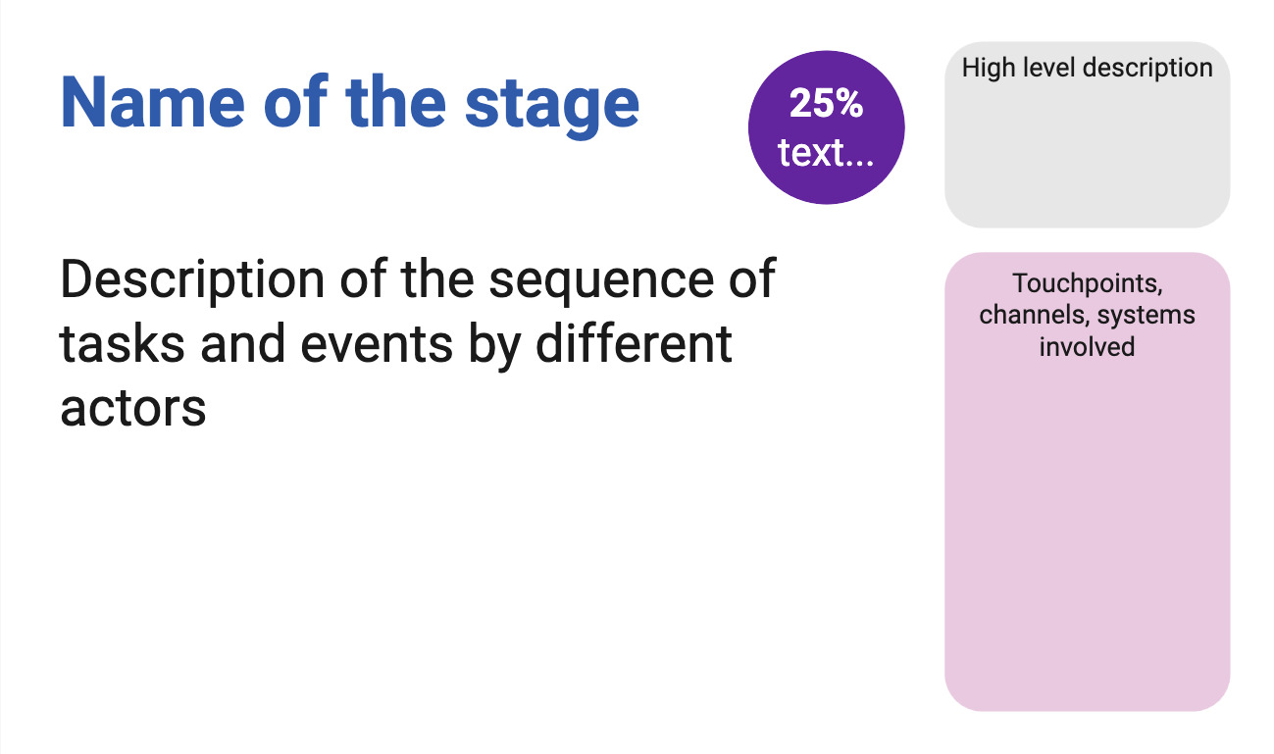
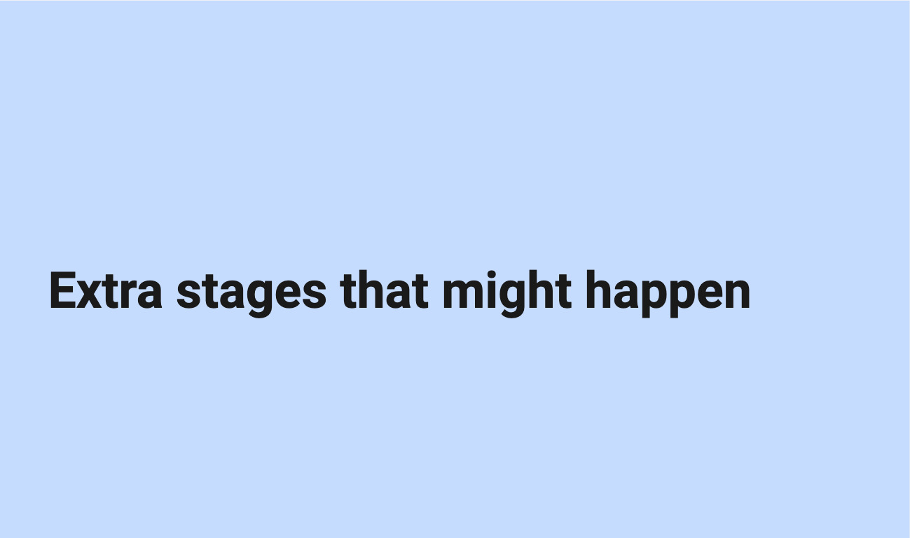
Example: Turning the service map visual into a deck (2)
Notes:
I start with the linear parts of the service and for each stage, I will provide a description of the sequence of tasks and events by different actors, I’ll add any data I might have about this step - For example the percentage of users failing to provide the evidence we need, I have a part of the slide where I give a high level description of the stage, and another to mention the touchpoints, the channels and systems involved.
once I’ve described all the stages in the linear part of the service, I have a section for extra stages which might happen or not: it could be about making an appeal to a decision or transferring to another service
And finally like for the other map, I always have a slide inviting for feedback and giving a contact to do so.

Slide 41
Pros and cons of alternative formats
time consuming
need to maintain two formats
→ more feedback and engagement from people who are not designers
→ improve my mapping
→ this is accessible for people who are colour blind, visually impaired and for some neurodivergent type
Notes:
not everyone understand visual representations, so text alternative can help.
it improves my mapping as sometime while doing the deck I realise that something is not quite right in the visual representation or it makes me realise that actually, there is a relation or a step I do not understand well enough to explain it in a sentence, so it needs more work.

Slide 42
Designing together
Notes:
In this last part before the recap, I’m focussing on another set of designer skills: Designing together.
This is about designing with your team, your stakeholders, but also with external and internal users and third parties. So here I’m mostly thinking about workshops, but it could be show and tell sessions, research or co-design as well.
Unless you have an amazing research culture in your organisation. you won’t be researching with disabled people that often
I think that the best way to have inclusion and accessibility in mind for your users is to start to really change the way you work with your own team and your stakeholders, as you work with them every day.

Slide 43
But there are no disabled people in my team
→ many disabilities are not visible
Neurodivergence in tech / creative industry:
→ over 20% - probably up to 50%
→ people sometimes don’t declare their disability
Notes:
You might be thinking, what is she on about? there are no disabled people in my team or among my stakeholders. And maybe you’re right.
But the problem is that people often think of disability as something that is visible and permanent. But many disabilities are not visible: like hearing and sight impairments, chronic pain and many more
Do you remember the statistic for neurodiversity? about 1 in 7 people in the general population but in tech and creative industries, it might be up to 50%
This is not visible. You might not know about it, but you surely should think about it.
Another thing to keep in mind is that people sometime don’t declare their disability to their employer/colleagues.
There might be a lot of reasons, I can give you some of mines:
before getting a role, I’m never completely sure people won’t hold this against me despite saying they don’t discriminate
once I have the role, I usually don’t talk about it because people might then treat me differently, or give me unwanted advice, or won’t believe me
I don’t want to be seen differently or have this used against me
I can do this because I don’t really need accommodations if I can work mostly from home. These days I’m more open about it because I’m more experienced.

Slide 44
Things can change
actual employees can become disabled
a new joiner might be disabled
→ Make sure your systems, processes and practice are accessible for all

Slide 45
Creating a safe space
Do not force people to disclose a disability or medical condition
→ offer help for everyone
Instead of providing accommodations for disabled people
→ offer various options to all
Invite for feedback and allow people to reach out privately
Notes:
So when you are designing with people, it’s important to create a safe space. Don’t force people to disclose a disability or medical condition. Instead, offer help for everyone.
We talk about ‘accommodations’ for disabled people, but it’s better to offer various options to all instead, so it doesn’t sound like you are making a big effort just for them and that way, it will benefit more people who might not have requested anything even though they might need it.
Invite for feedback, and allow people to reach out privately: it’s not easy to talk about your needs in public, or in a group during a meeting.

Slide 46
Don’t assume you know what is best
People don’t have the same needs even if they have the same condition, and needs vary in different contexts.
always best to ask what would help
have that discussion with the person
do not assume you’re doing the right thing

Slide 47
Manual of me
Examples of sections:
condition I like to work in
time and hours I like to work
best way to communicate with me or provide feedback
things I’m good at
things I might need help with
how I like to be helped
help you tell others what you need
learn about what other people in your team needs
Do not make people share more than they are willing to
Notes:
A ‘manual of me’ can be a great tool to communicate what you need to work well with the rest of your team. I’ve been doing this in project teams for a while and found that it helps me to tell people what I need and also to understand them better.
In there for example, I will explain that I struggle with numbers, names and acronyms if I do not have a visual support for them and you just say them, because I’m French and my brain does the little gymnastic of translating things so it slows me down, but if I have a visual, I instantly recognise it.

Slide 48
Organising - hosting a meeting / workshop
before the session: set expectations, provide an agenda, do it again at the start of the actual session
invite people to tell you if this might not work for them
if using online tools like Mural or Miro, plan for an alternative
if over an hour → plan for a break and stick to it
repeat the question someone asked before answering unless you’re sure everyone has heard/seen it

Slide 49
Presenting during a meeting
share your slides at the start of a presentation or in your invite
keep content short and simple, test the accessibility of the deck
use a mic, speak facing your audience, camera on if online
leave some space at the bottom of your slides
describe any image/ diagram, assume at least one person cannot see
don’t assume people can read the text on slides

Slide 50
Getting people in a physical venue
access to toilets
enough space to move around
can the light be controlled
sitting arrangement - standing
provide photos or video of the space, and how to get there
plan more time!
Notes:
Earlier, I provided guidance from Scope about physical accessibility at a venue and they have an accessible events toolkit

Slide 51
Key takeaways

Slide 52
Designing for everyone - recap
think about accessibility right from the start
do not forget about internal users
consider neurodivergence and low numeracy in particular
ask for feedback
focus on: integration with other services, questions, consistency
Notes:
accessibility should be addressed right from the start and all along, this includes neurodiversity
make sure anyone can give feedback in a way that suits them, so you can learn how to improve and keep iterating

Slide 53
Design communications
provide alternative formats for your visuals and maps
check colour contrast especially for your text
do not rely on colour alone to convey meaning
use plain language and explain acronyms
be careful with numbers
use accessibility checkers for your slides and word documents
send your presentation ahead of the meeting

Slide 54
Designing together
do not assume there are no disabled people in your team
consider neurodivergence
do not assume you know what is best
use manuals of me

Slide 55
More resources

Slide 56
About accessibility and neurodiversity
Past videos (of the Accessibility Scotland conference)
Inclusive Design 24 online and free, in particular this video: How to be inclusive to neurodivergent people - Rachel Morgan-Trimmer
Public neurodiversity support center
Estimate how many people using your website might be disabled

Slide 57
Guidances
DWP Accessibility manual
Accessibility and inclusive design manual from the Department for Education
Scope: checking the accessibility of an event or venue and accessible events toolkit
Accessible numbers project

Slide 58
Some of my blog posts
Different levels of inclusion awareness
Inclusion in the workplace
Avoiding misconceptions on your accessibility learning journey
Removing barriers to inclusion
Advice for speakers (to present in an accessible way)
Is my website accessible?

Slide 59
Thank you!
To Craig Abbott, Tom Napier, Alice Forward, Lindsay Stephens, Shalom Jesusanmi, Helen Spires, and the whole DWP Service Design Community
And thank you for listening!

Slide 60
Any question?
Get in touch: french@chezleskrus.com

